Slide 1
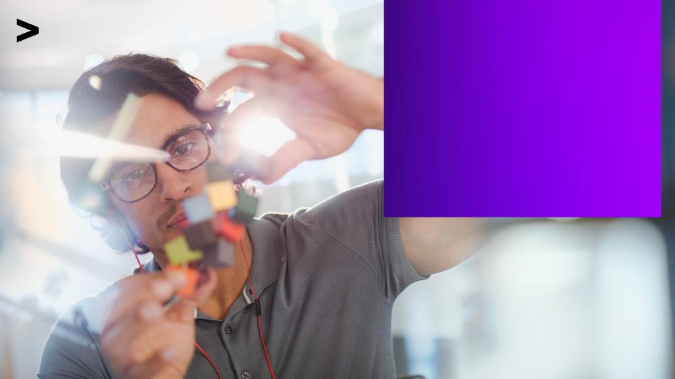
Accenture
Innovation Challenge
Innovate to create
360° value
Let there be change

Slide 2
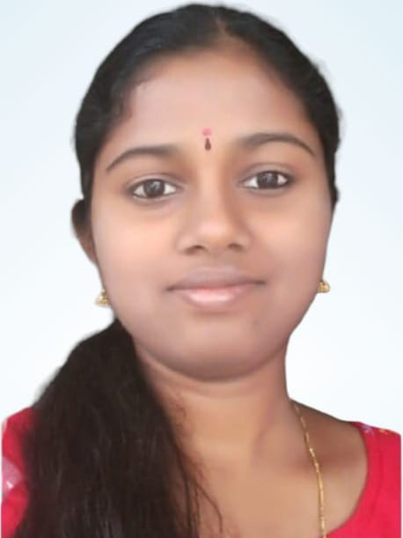

Team details
TEAM NAME:Techwarriors
Lahari Jakkireddy(Team Leader)
College: Sri Mittapalli college of Engineering
Stream: Computer science and engineering
Year of graduation:2023
All fields are mandatory

Slide 3

Theme
Please highlight one from the below:(Choose one and highlight it)
Innovate For Business
Develop innovative business solutions, offering or a business model that disrupts the competition in the given industry space
Innovate for Business
Innovate for Society
Innovate For Society
Apply technology in innovative ways to help improve the way we work and live, and create value for our society
Innovate for a Sustainable World.
Innovate for a Sustainable World
Develop innovative business to tackle some of the world’s greatest ‘environmental challenges’

Slide 4

CERTIFICATE DUPLICATION
Certificate duplication is the majour issue happening nowadays and got mostly expanded during covid 19.
Our examination results certificates are stored in a centralized server database, for which one can create a proxy and can edit the details where nobody can not find who edited that data.
Many universities are producing fake certificates.
Lets look at a situation:
There is a doctor who came into the service through fake certificates without having proper education and they experiment on patients which lead to a huge life loss.
Many people are producing fake certificates even to the recruiters in IT industry.

Slide 5
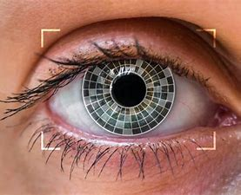

MY SOLUTION
My solution for this problem is “Block chain technology”.
First of all for the students before taking the exam should make their Iris scanned in concerned centers and this scanned iris will be stored in a block chain network.
As block chain network is a decentralized one, and there is a factor of digital signature here if anyone done changes in this stored iris they can be easily caught.
According to the research in any person Iris remains constant at least for a month.
On the day of exam iris of a student is compared with previous iris in block chain and then matched one are allowed to write exam. This proves that the student have attended that particular exam.
After the exams government should enable to store the results in the block chain network.
Now for the students who got iris matched are given certificates entering the result of that particular subject and if iris is not matched that means he/she did not attend for the exam and treated as absent.
In this way fake certificates can be avoided.
Describe TECHNOLOGY USED : Example – Iris technology and block chain technology.

Slide 6

MY INNOVATION CREATE 360° VALUE
It can be applicable all over the world as iris scans are not that much difficult and block chain being decentralized network, it can be accessed from anywhere through out the world.
And the possibility of hacking block chain network is very less.Acually it gets hacked if more than 50% of blocks gets hacked, but as digital signature is there any changes done can be easily visible to all and it can be protected at every instance.
Here the people who take iris scan should have little knowledge about eye ball anatomy and remaining everything based on program we induce will be implemented automatically.
So my idea is applicable all over.
Learn more about how we deliver 360° value
https://www.accenture.com/in-en

Slide 7

MY SOLUTION DIFFERENT FROM OTHER SOLUTIONS IN MARKET
Actually in market in real time just iris is scanned in examinations like NEET,JEE,UPSC etc....but that data they will store in a database which is centralized and can be manipulated easily,
Which is not at all possible with my idea of implementation using block chain and iris technology.
My model is reliable compared to models in market.
Block chain can hold large amount of data compared to the ones in the market.
PATENT FILED: Yes
Do you have a working model/prototype: Yes
If not, will you be able to show working prototype during finale. Yes/No

Slide 8
Any testimonials received?
NO
Share the links/photos of the testimonials you’ve received

Slide 9
Our elevator picture video:
https://drive.google.com/drive/folders/1zVrkRERfHb5MWd04zceg37Ehkbh71fUj

Slide 10
Thank you!

